Slide 1
Build an Alexa Skill for the Amazon Echo

Slide 2
Presenters
Bill Klug
Cloud Computing Option Head & Instructor
BCIT
Artur Rodrigues
Senior Solutions Architect
Amazon Web Services

Slide 3
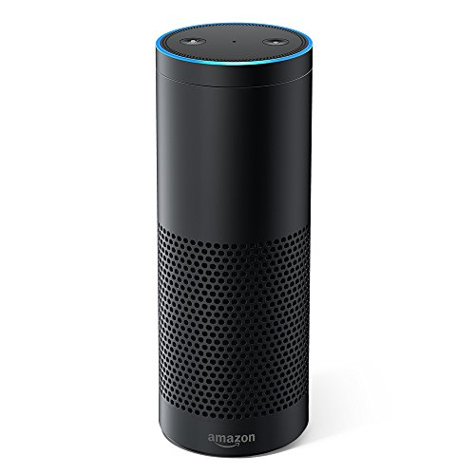
Amazon Echo

Slide 4

Alexa

Slide 5
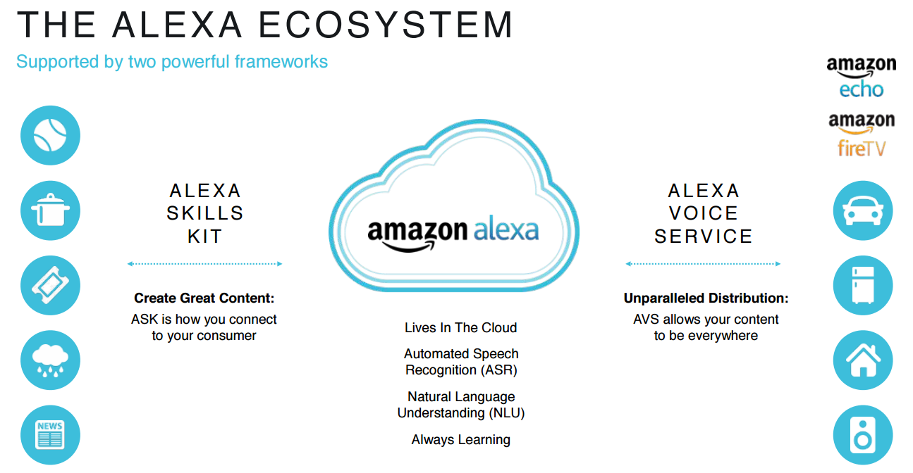

Slide 6
Create Your Environment
Create an AWS account
https://aws.amazon.com
Install the AWS CLI
https://aws.amazon.com/cli/
Works with PowerShell or Git Bash

Slide 7
Developer Links
AWS Console
https://aws.amazon.com/
Amazon Developer Portal
https://developer.amazon.com/
Amazon Alexa Account
https://alexa.amazon.com
Alexa Skill Testing Tool
https://echoism.io

Slide 8
Configure Your Environment
Download your AWS Access Key ID & Secret Access Key
AWS Console – IAM
Login into your AWS account from the CLI
aws configure

Slide 9
Install Your Language
Install Node.js
https://nodejs.org/en/
node -v
npm -v
Install Python
https://www.python.org/downloads/
python --version

Slide 10
Alexa Node.js SDK
https://github.com/alexa/alexa-skills-kit-sdk-for-nodejs
npm install --save alexa-sdk

Slide 11
Text Editor
Visual Studio Code
https://code.visualstudio.com/
Atom
https://atom.io/

Slide 12
Code Files on GitHub
Create a directory on your laptop
https://github.com/bklug/bcnet-alexa-workshop
Download the zip file to the directory
Open the “00-hello-basic-skill” folder in your editor
In the Lambda directory:
npm install --save alexa-sdk

Slide 13
Voice Model Components
Intent Schema
Voice “slots” that capture words spoken by the user
Sample Utterances
Phrases used to invoke the intents
Custom Slot Types
User-defined voice slots versus built-in intents
Lambda code
Processes user interaction with the device

Slide 14
Amazon Developer Portal (1)
https://developer.amazon.portal
Create a skill - “BCNET 2018”
Custom skill
Skill invocation name – “b c net”
Spaces important!
Save Model
Add an Intent – “Hello”

Slide 15
Amazon Developer Portal (2)
Add the Sample Utterances
Intent name followed by a phrase
Save Model
Build Model
Important – Enable testing for the skill!

Slide 16
Lambda Code (1)
Index.js
exports.handler parameters
Event – JSON file sent from device to the handlers
Context – runtime information
Callback – optional; returns information to the caller. (We’ll use this later.)

Slide 17
Lambda Code (2)
Handlers
LauchRequest intent
Hello intent
You should have one for each intent
Not required for built-in intents
Good practice, however, to include them

Slide 18
Lambda Function (1)
https://aws.amazon.com
Create a function from scratch
Name – “bcnet-2018”
Runtime – Node.js 6.10
Choose an existing role
lamba_basic_execution

Slide 19
Lambda Function (2)
Add triggers
Alexa Skills Kit
Save

Slide 20
Lambda Function (3)
Copy the Lambda function ARN to your skill in the developer portal
On the left, select Endpoint
Service Endpoint Type
AWS Lambda ARN
Paste ARN into the Default Region field
Save Endpoints

Slide 21
Deploy Lambda Code (1)
From your terminal window, navigate to the lambda directory under “00-hello-basic-skill”
Run “npm install --save alexa-sdk”
Installs the Alexa SDK (node_modules)

Slide 22
Deploy Lambda Code (2)
Mac or Linux – execute the publish_lambda.sh
Windows
PowerShell “compress-archive” won’t work
From File Explorer, select the files in the lambda directory (not the lambda dir. itself)
Send to -> Compressed (zipped) folder
Save as lambda.zip

Slide 23
Deploy Lambda Code (3)
From your terminal window, navigate to the directory containing the lambda.zip file
Copy and paste the last line in the publish_lambda.sh file
Make sure the --function-name makes the lambda function in the AWS console

Slide 24
Test Your Skill (1)
In the Alexa console, select Build.
Verify the skill builder checklist is green
Select Test
Enable test for this skill

Slide 25
Test Your Skill (2)
Alexa Simulator
Type “open b c net” or
Click and hold the microphone and speak
“ Alexa, open b c net”
Then, type or speak an utterance
“Hello”
“Hi”

Slide 26
JSON Request and Response
Alexa Simulator - type “open b c net”
Copy the JSON Input code
Go to your Lambda function in the AWS console
Click the Test button and paste the code
View the Execution results
Should match JSON output in Alexa console

Slide 27
Request and Response JSON Reference
https://developer.amazon.com/docs/custom-skills/request-and-response-json-reference.html

Slide 28
Your Alexa Account
Log into https://alexa.amazon.com
Notice the output from your skill
Do you have the Alexa app on your cell phone?
Output from your skill will appear there, too

Slide 29
Finish This Skill
Add Lambda code to handle these three, built-in intents
StopIntent
CancelIntent
HelpIntent
Test each built-in intent

Slide 30
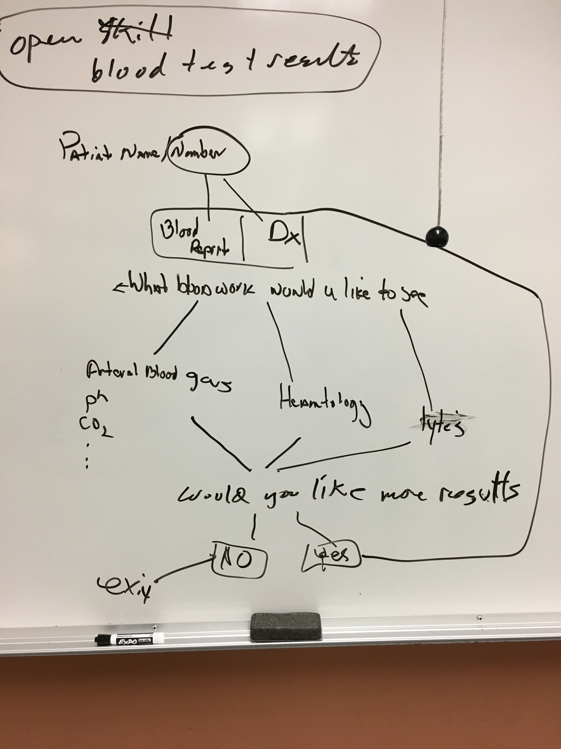
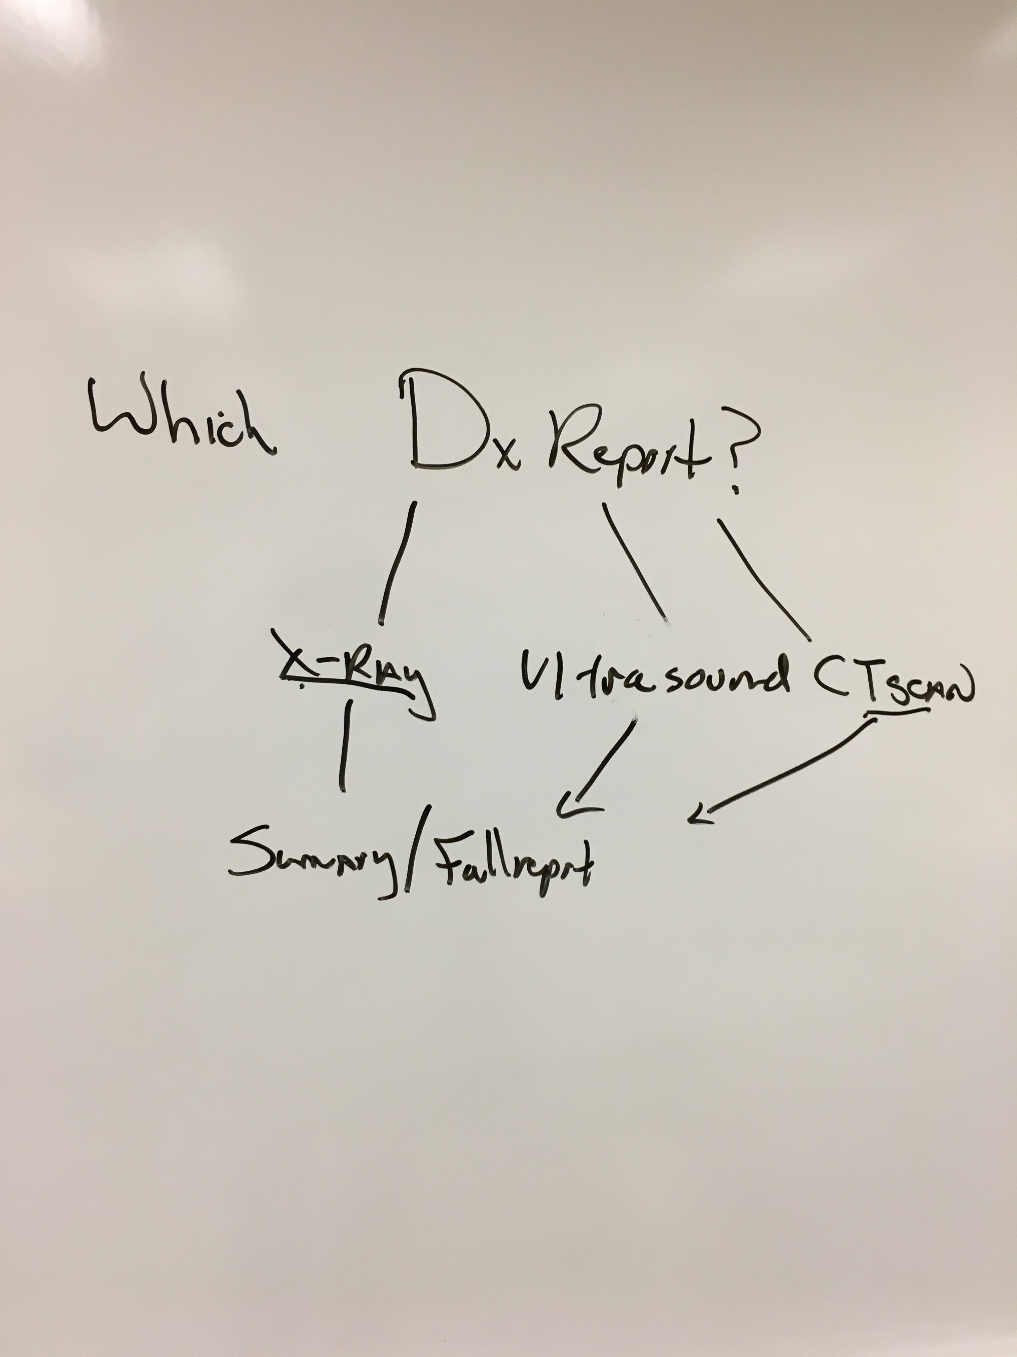
Patient Test Results

Slide 31
Blood Test Results Skill (1)
Custom Slot Types
Gather user data
Slot Type Reference
https://developer.amazon.com/docs/custom-skills/slot-type-reference.html
Session Attributes
Store input data between intents

Slide 32
Blood Test Results Skill (2)
“01-blood-test-results”
Speech Assets
Intent Schema
Sample Utterances
Modify the skill in the developer portal
Remove Hello intent
Add YesIntent
Add NoIntent
Add intent slot for patient number
Add sample utterances

Slide 33
Blood Test Results Skill Code
Data directory
bloodWork.js
bloodWorkRanges.js
displayBloodResults.js
Index.js
New intents
Storing patient number – session attribute
Cards
Displays information in Alexa app

Slide 34
Blood Test Results – Segmentation (1)
“02-blood-test-segmentation”
Blood Test Results versus Diagnostic Tests
Blood Test Results
Hematology
Arterial Gas
Electrolytes

Slide 35
Blood Test Results – Segmentation (2)
Speech Assets
LanguageModel.json
SampleUtterances.txt
You don’t need to add all of these!
Constants Directory
Constants.js

Slide 36
Blood Test Results – Segmentation (3)
Update the model in the developer portal
First, add custom slot type values for these intents
ReportTypes
BloodReportTypes
Next, add new intents that use new slot types
Add ReportType intent
Add BloodReportType intent

Slide 37
Blood Test Results – Segmentation (4)
Add one utterance to each new intent
ReportType - {Type}
BloodReportType – {BloodType}
Save Model
Build Model

Slide 38
Blood Test Results – Data Decoupling
Store patient data in cloud storage
AWS S3 - Simple Storage Service
Data stored in buckets

Slide 39
AWS S3
Log into the AWS console
Create an S3 bucket
Bucket names must be globally unique!
Upload file from data directory “blood-results.json”
Change IAM role to allow Lambda function to read S3 bucket (or create a new role)
lambda_basic_execution
AmazonS3ReadOnlyAccess

Slide 40
Blood Test Results – S3 Bucket (1)
“03-blood-test-S3-bucket”
Constants.js
Add skill App ID
Specify S3 bucket & file name (key)
New directory Helpers
Function to read S3 bucket
getBloodWorkS3.js

Slide 41
Blood Test Results – S3 Bucket (2)
Index.js
NewSession Intent
Loads patient data from S3 bucket
Stores in session attribute
Calls LaunchIntent

Slide 42
Patient Test Results

Slide 43
Patient Results States
Blood Test Results versus Diagnostic Tests
Blood Test Results
Arterial Blood Gas
Hematology
Electrolytes
Diagnostic Tests
X-Ray
Ultrasound
CT Scan

Slide 44
State Management
Patient identification
Blood test results
Diagnostic reports

Slide 45
Patient Results States (1)
“04-patient-results-states-v1”
Developers portal
Add Diagnostic tests to model
See LanguageModel.json
Major change to index.js
Adding three states

Slide 46
Patient Results States (2)
“04-patient-results-states-v2”
New directory - handlers
Create separate file for each handler
patientIdentificationStateHandlers
bloodTestsStateHandlers
diagnosticReportsStateHandlers

Slide 47
Your Turn
“Quote-of-the-Day” skill
Intents
Greet the user – Hello Intent
Get a quote – Quote Intent
Request another quote – NextQuote Intent
GetQuote function is in GitHub
Use “00-hello-basic-skill” as starting point

